Slide 1
Serialization and use of SBOL
SBOL in Action
Michal Galdzicki
SBOL Meetup
June 5, 2012

Slide 2
Generate SBOL; Use SBOL
1. Provide information from a parts registry in SBOL RDF/XML format
Converter
2. Distributed repositories project
Prototypes of retrieval interfaces
WikiDust
Magpie

Slide 3
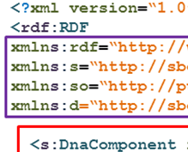

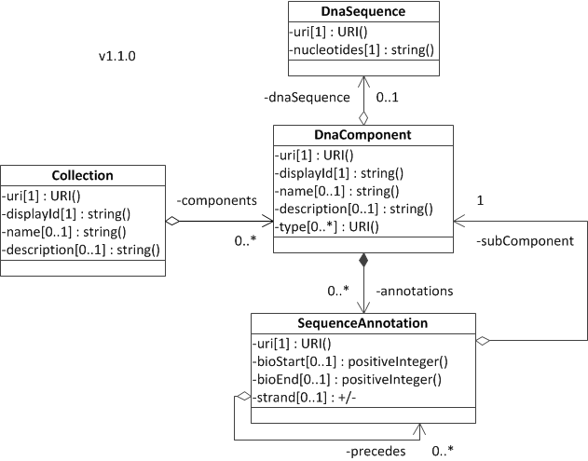
Converter
SBOL Core
Source
Transform
Serialize
SBOL
format
1

Slide 4
Converter
SBOL Core
Source
Transform
Serialize
Output
Request:
http://convert.sbols.org/biobrick/BBa_T9002
Demo
Response:
SBOL Format Document
1
http://partsregistry.org/Main_Page

Slide 5
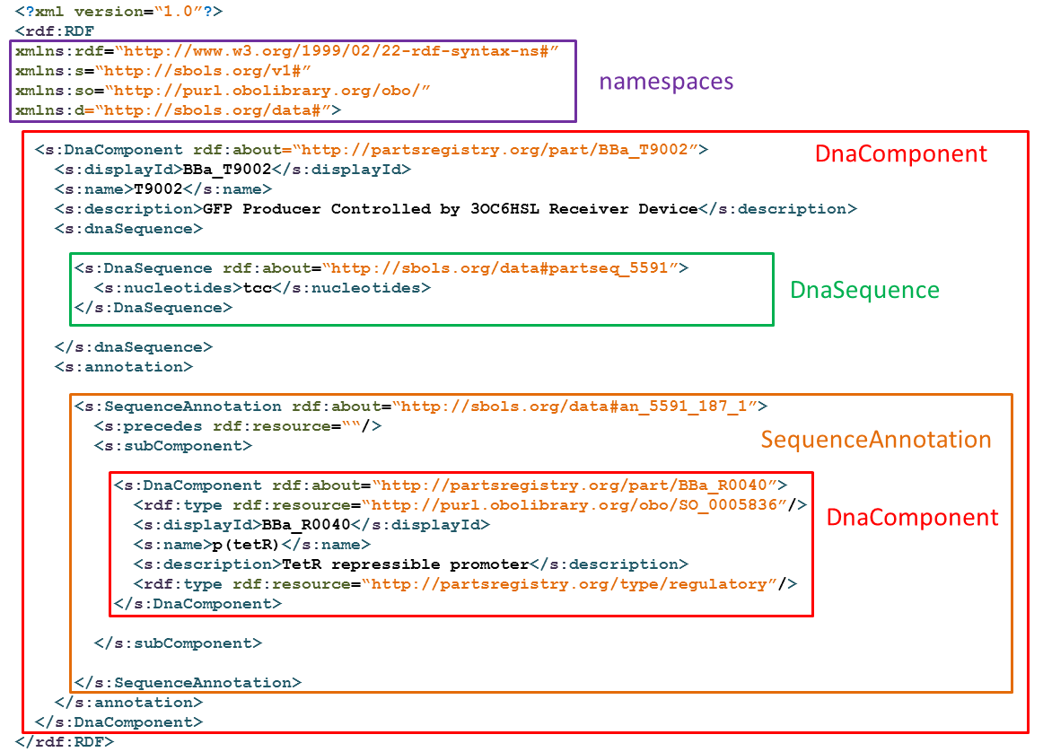
SBOL Serialization
1

Slide 6
Considerations for the converter
Define namespaces
Language and Data namespaces
Registry part namespace
xmlns:prp="http://partsregistry.org/part/"
Define Data Mappings
Map types to Sequence Ontology
Understand the Data Mappings
1

Slide 7
Example of data specific semantics - Heuristic solutions for Data Mappings
s:name of DC - part or subpart p:nickname,
if it exists, else p:part_short_name (ie the Part ID without the BBa_).
Messy reality… Non standard “features”
Features have a "title" which can have a BBa_ name or a displayId.
When parsing features I distinguish between the features which were already declared from a subpart element. If the title is a BBa_ string this means its uri sometimes matches a previously parsed subpart.
1

Slide 8
2. Distributed Repositories Project
SBPkb
Bacillo Bricks
+N Registries/ Repos
“BioBricks”
SBOL
SBOL
SBOL
“Get” DNA components
2

Slide 9
Distributed Repositories Project
SBPkb
Bacillo Bricks
+N Registries/ Repos
“BioBricks”
Choose an appropriate
architecture
“Get” DNA components
What will you “see” / do here?
2

Slide 10
Prototype Interfaces of integrated views
MAGPIE
Browse collection
From distributed knowledgebase
WikiDust 2
Build query
Retrieve components for design
Demo
http://magpie.goldbricks.org/
Demo
2

